Slide 1
The Physics-informed AI Climate Model Agent Neuro-symbolic Simulator (PACMANS) for Tipping Point Discovery
Jennifer Sleeman (PI )(APL), Jay Brett (APL), Marisa Hughes (APL), Anand Gnanadesikan (Co-PI) (JHU), Yannis Kevrekidis (Co-PI) (JHU), Thomas Haine (JHU), Marie-Aude Pradal (JHU), Anshu Saksena (APL), Chace Ashcraft (APL), David Chung (APL), Larry White (APL), Renske Gelderloos (JHU)
Presented on 3/15/2022 – DARPA ACTM Working Group Meeting
DISTRIBUTION STATEMENT A: Approved for public release: distribution unlimited.

Slide 2
Outline
What climate phenomena (tipping point) are we addressing?
AMOC
What data/models are we using?
The Gnanadesikan four box model
Mapping CMIP6 to the box model
What methods are we applying?
AI Surrogates and Bifurcation Method
Multi-Generator GAN Exploration
Neuro-symbolic Language Exploration
What did we learn?
Lessons and Adaptations

Slide 3
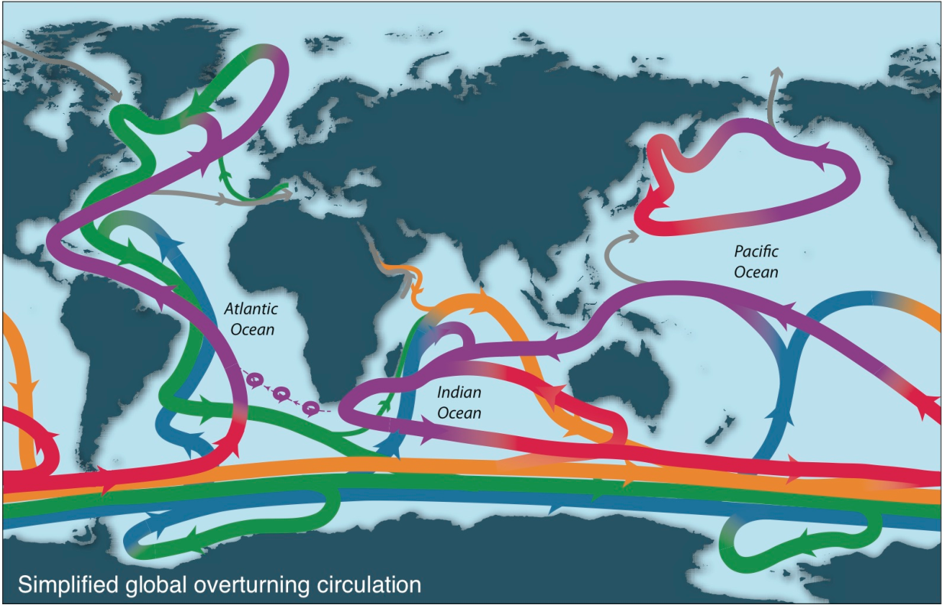
The Atlantic Meridional Overturning Circulation (AMOC)
Goal of this work is to use machine learning to learn how to perturb parameters to invoke different pathways to collapse (weakening) of the AMOC
The AMOC is critical to global climate
Understanding the behavior of the AMOC using ML could guide oceanographers to better model the problem
Understand why there is disagreement in simulating the AMOC across models
Schematic of overturning (Talley, 2013)
Deep circulation (green/dark blue) driven by very small regions! But has major impact on heat, carbon, and oxygen.

Slide 4
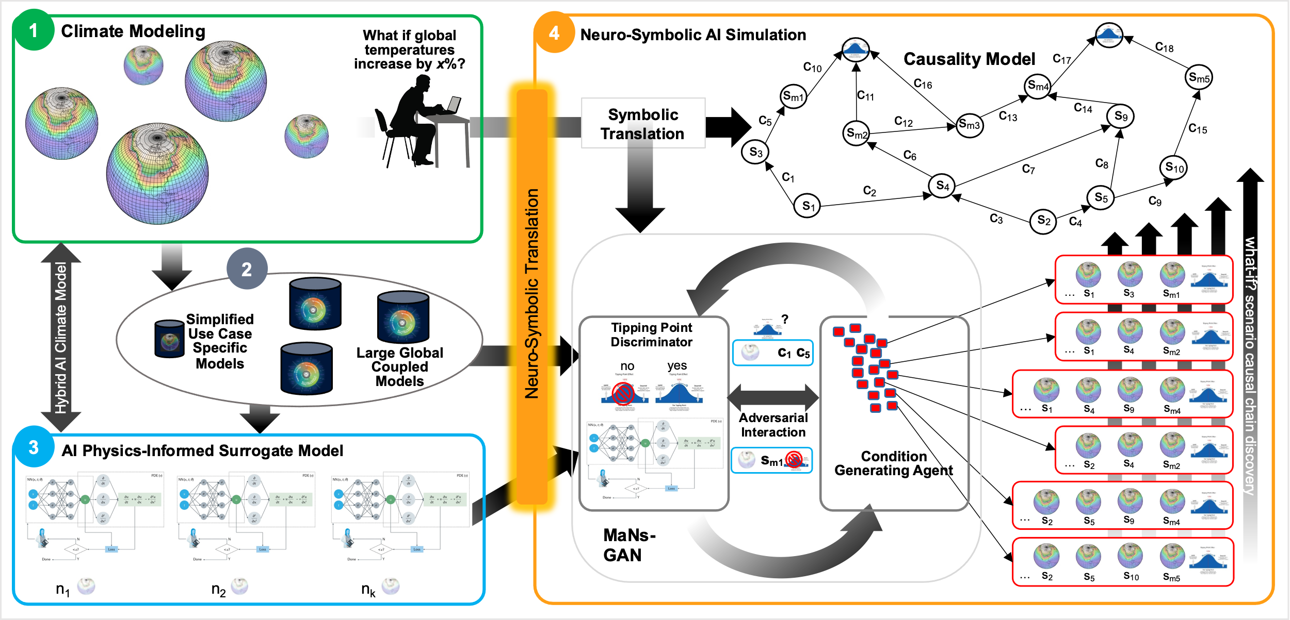
PACMANS
The Physics-informed AI Climate Model Agent Neuro-symbolic Simulator (PACMANS) for Tipping Point Discovery Framework.

Slide 5
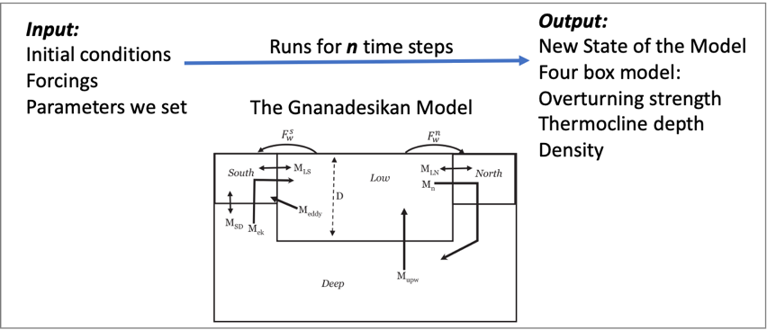
The Gnanadesikan Four Box Model
Using the Four Box Model as a way to generate data for the AI methods
For long time scales, Atlantic overturning can often be described by simple box model
The Gnanadesikan Four Box Model

Slide 6
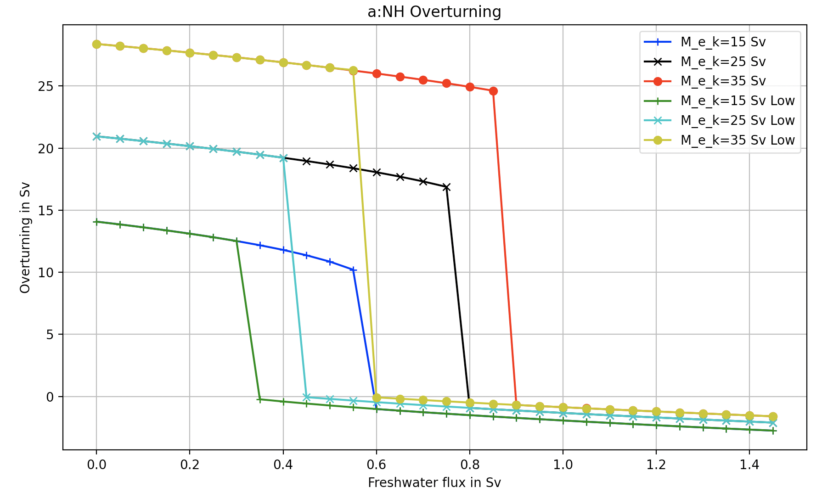
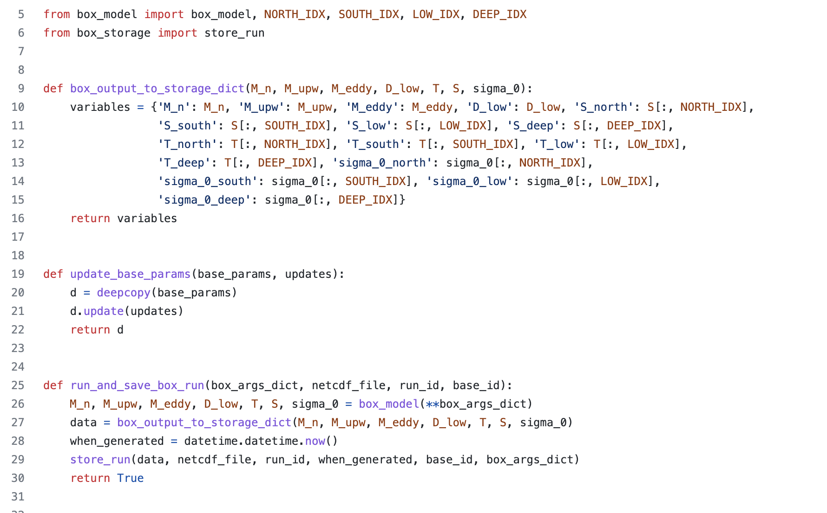
The Gnanadesikan Four Box Model
We have created a python package of the four box model that allows one to specify initial conditions, and parameter values
The python package recreates the Gnanadesikan experiments (in Matlab code)
Generates the same plots
Enables creation of labeled training data for training machine learning algorithms and temporal training data for training the AI surrogates

Slide 7
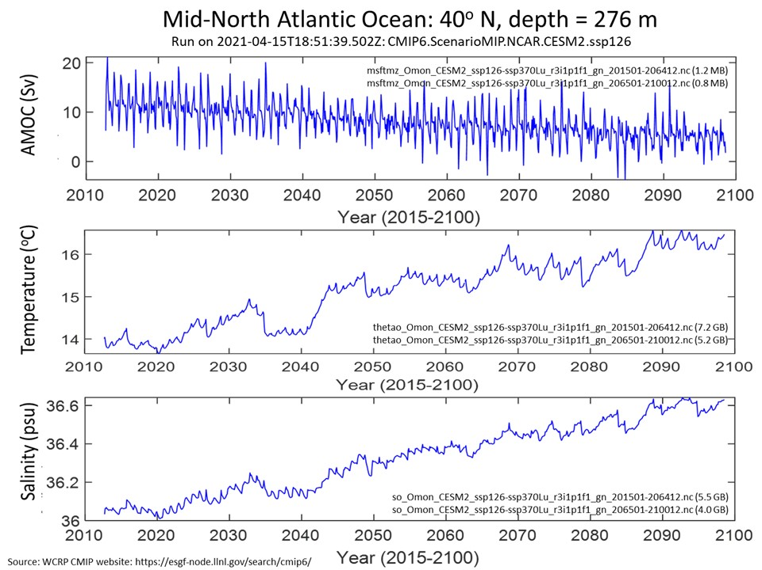
Mapping CMIP6 to the Box Model
NCAR CESM2 SSP126

Slide 8
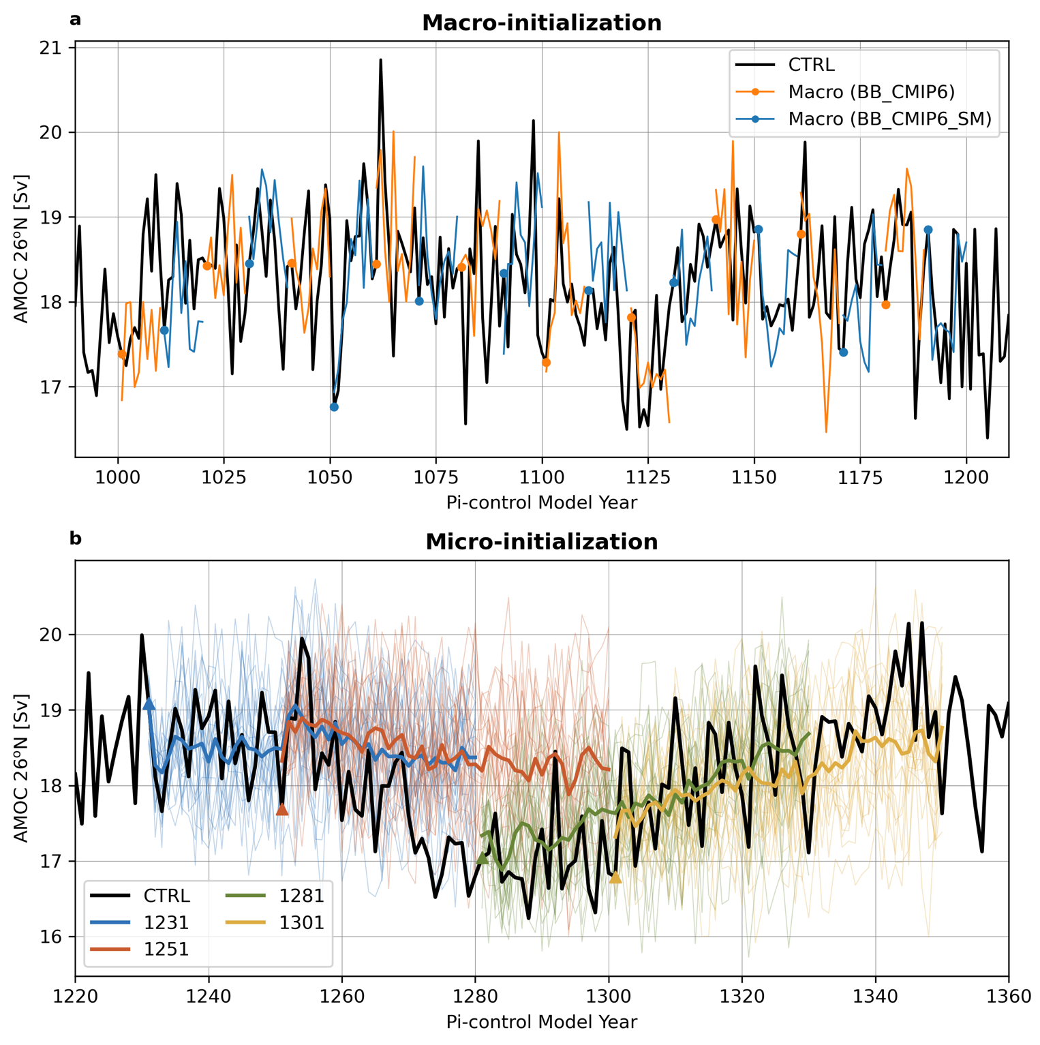
Mapping CMIP6 to the Box Model
CESM Large Ensemble
CESM2-LE initialization consequences for the Atlantic Meridional Overturning Circulation (AMOC) at 26.5°N with 20 macro-initializations (top) and the micro-initializations (bottom).

Slide 9
AI Surrogates and Bifurcation – Methodology Plan
Tipping point computation plan for the stochastic Box model:
Reduced set of models focused on areas around tipping points
Trained to learn tipping points using coarse bifurcation signatures
Developing one-parameter bifurcation diagrams of the (deterministic part) of the box model (9 differential equations) with respect to the separate parameters
In neighborhood of tipping point, the model reduces to an effectively one-dimensional model since one eigenvalue is close to zero
Then stochastic simulations will give rise to time series “jumping” across different states

Slide 10
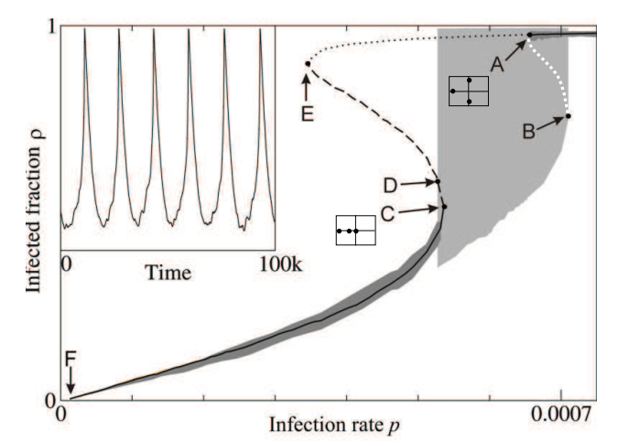
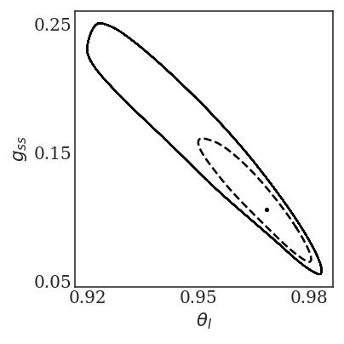
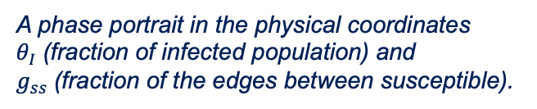
AI Surrogates and Bifurcation – Methodology Plan
Demonstration of components:
Adapting an existing method that was used for the epidemic problem, and applying to the AMOC problem
Performing network dynamic stochastic simulations for various parameter values
(Gross T. et al 2008) System-level bifurcation diagram. Branches of stable steady states (solid lines) and saddle points (dashed/dotted) have been computed by a coarse-grained Newton method.
A phase portrait in the physical coordinates $θ_{Ι}$(fraction of infected population) and $g_{ss}$(fraction of the edges between susceptible).

Slide 11
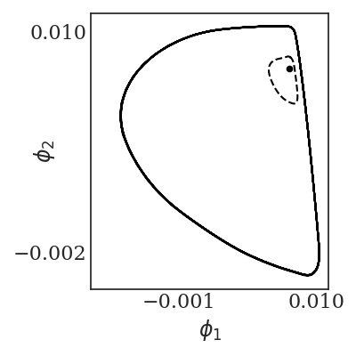
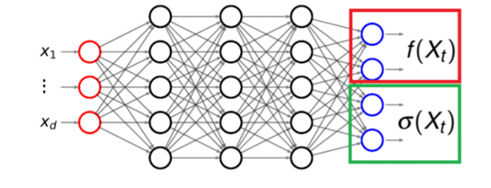
AI Surrogates and Bifurcation – Methodology Plan
We use a neural network, shown below (left), to learn the effective SDE
The “tipping point” reduced phase space – a stable steady state coexisting with a large amplitude oscillation; the separatrix is the unstable limit cycle shown in a broken line.
The tipping point (two attractors and the separatrix) is shown in data driven observable space is shown below (right).
Figure 4. A caricature of the Neural Network architecture used to learn the drift and diffusivity of the stochastic differential equation
In latent space: The coexistence of a big stable limit cycle, an unstable limit cycle (the separatrix) and a stable steady state in the leading two data-driven, Diffusion Maps coordinates.

Slide 12
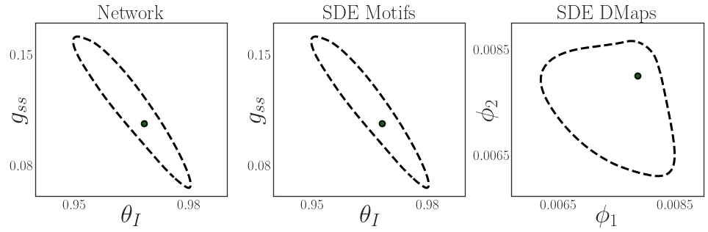
Surrogate Dynamics

Slide 13
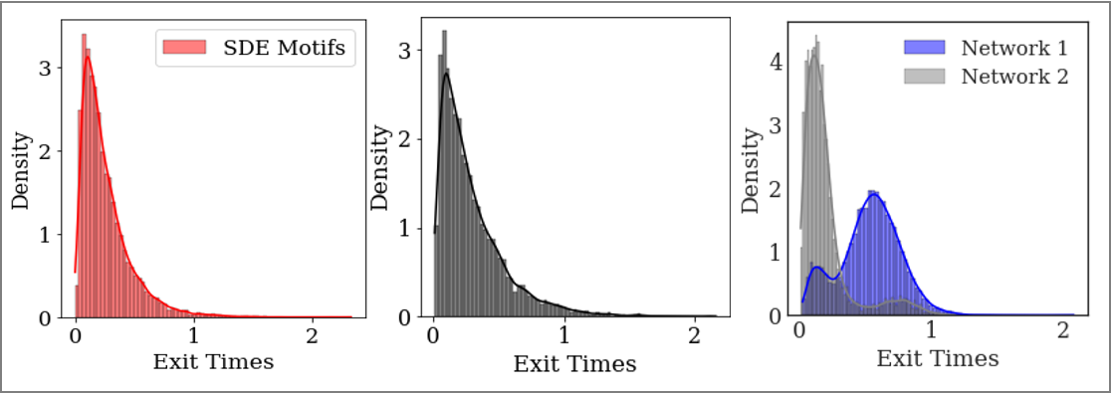
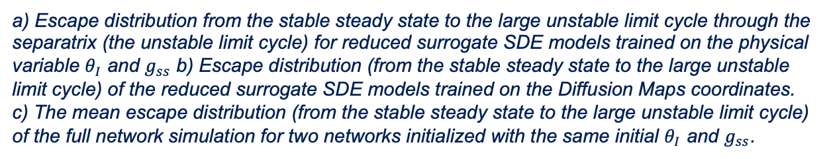
AI Surrogates and Bifurcation – Methodology Plan
Escape time distribution computations are shown below a, b, and c.
a) Escape distribution from the stable steady state to the large unstable limit cycle through the separatrix (the unstable limit cycle) for reduced surrogate SDE models trained on the physical variable $θ_{Ι}$ and $g_{ss}$ b) Escape distribution (from the stable steady state to the large unstable limit cycle) of the reduced surrogate SDE models trained on the Diffusion Maps coordinates. c) The mean escape distribution (from the stable steady state to the large unstable limit cycle) of the full network simulation for two networks initialized with the same initial $θ_{Ι}$ and $g_{ss}$.

Slide 14
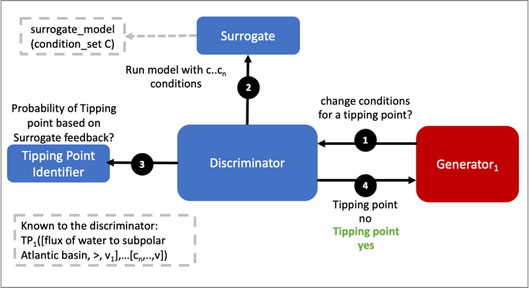
Multi-Generator GAN Exploration
Using a GAN with multiple generators
Generators perturb parameters to invoke a collapse
Discriminator learns how to adjust additional parameters to avoid collapse
Box model is the surrogate to start
Interactions between the discriminator and the generator seeking to exploit tipping points.

Slide 15
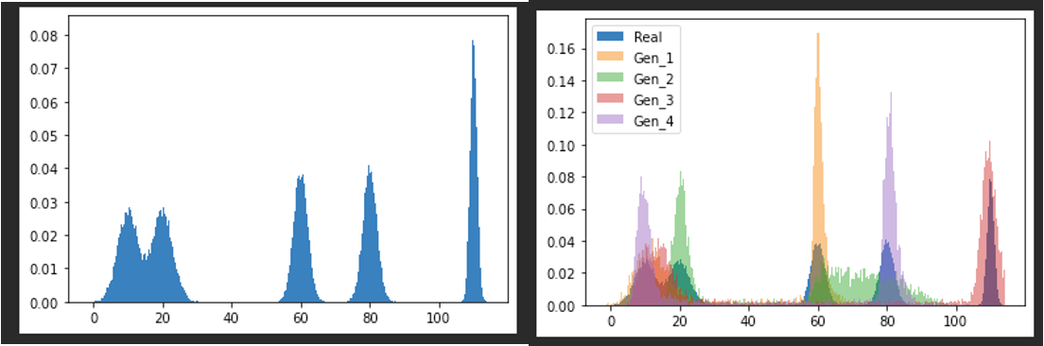
Multi-Generator GAN Exploration
Early experimentation involved learning more about the adversarial setup with multiple generators
Built a GAN using MAD-GAN architecture
Our early experiment of a 1-D non-parametric density estimation using MAD-GAN
5-component 1-D Gaussian Mixture Model (GMM) (left) and overlay of a Sample of Generator Outputs (4) (left) after 50,000 updates

Slide 16
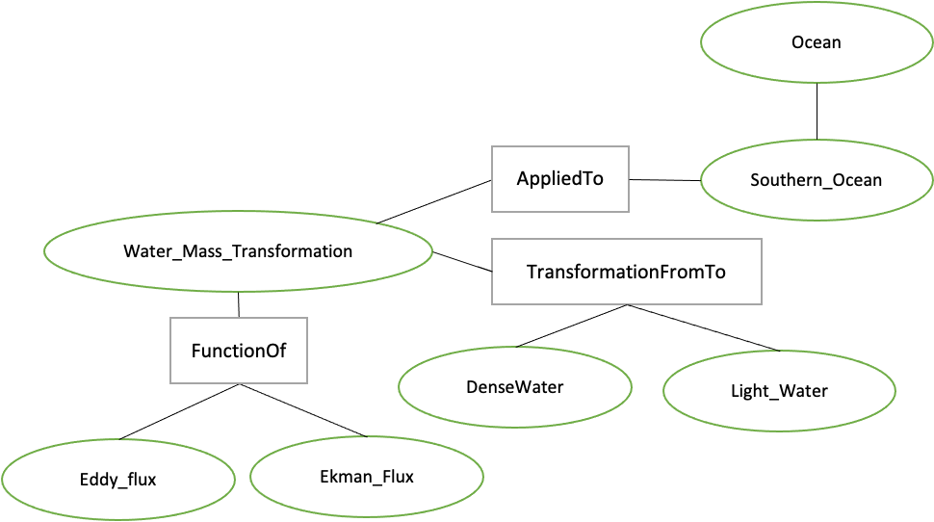
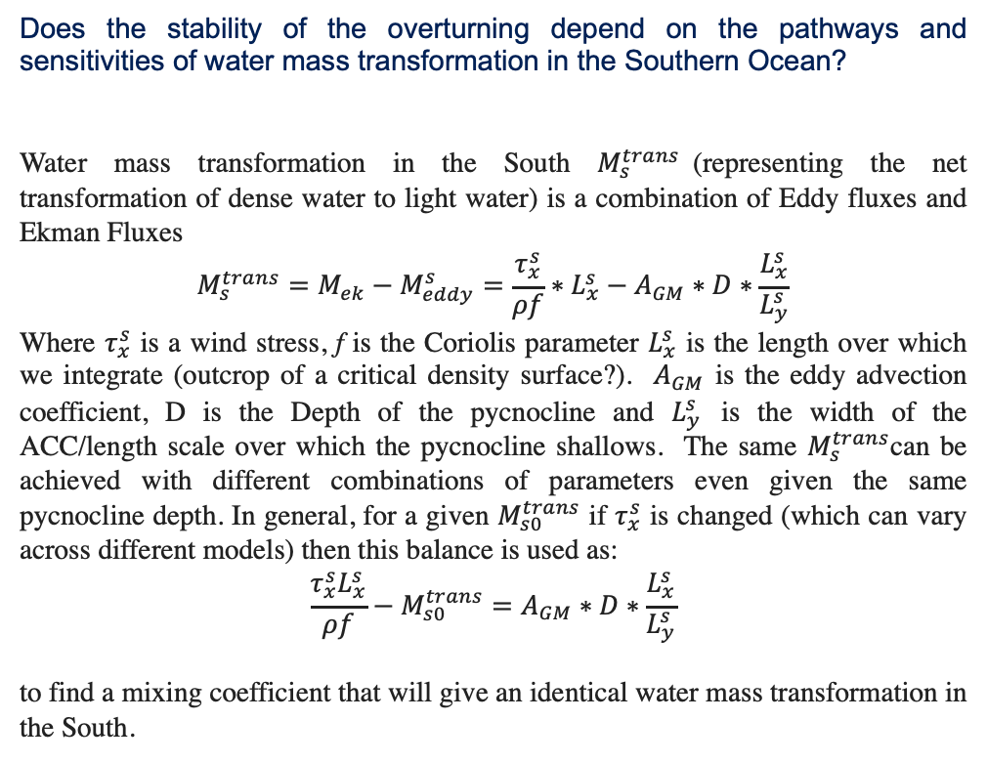
Neuro-Symbolic Language Exploration
Working on translating a question symbolically and mapping the question to box model parameters.
Does the stability of the overturning depend on the pathways and sensitivities of water mass transformation in the Southern Ocean?
Water mass transformation in the South $M_{s}^{trans}$(representing the net transformation of dense water to light water) is a combination of Eddy fluxes and Ekman Fluxes
$${M_{s}^{trans}=M_{ek}−M}_{eddy}^{s}=\frac{τ_{x}^{s}}{ρf}∗L_{x}^{s}−A_{GM}∗D∗\frac{L_{x}^{s}}{L_{y}^{s}}$$
Where $τ_{x}^{s}$ is a wind stress, f is the Coriolis parameter $L_{x}^{s}$ is the length over which we integrate (outcrop of a critical density surface?). $A_{GM}$ is the eddy advection coefficient, D is the Depth of the pycnocline and $L_{y}^{s}$ is the width of the ACC/length scale over which the pycnocline shallows. The same $M_{s}^{trans}$can be achieved with different combinations of parameters even given the same pycnocline depth. In general, for a given $M_{s0}^{trans}$ if $τ_{x}^{s}$ is changed (which can vary across different models) then this balance is used as:
$$\frac{τ_{x}^{s}L_{x}^{s}}{ρf}−M_{s0}^{trans}=A_{GM}∗D∗\frac{L_{x}^{s}}{L_{y}^{s}}$$
to find a mixing coefficient that will give an identical water mass transformation in the South.

Slide 17
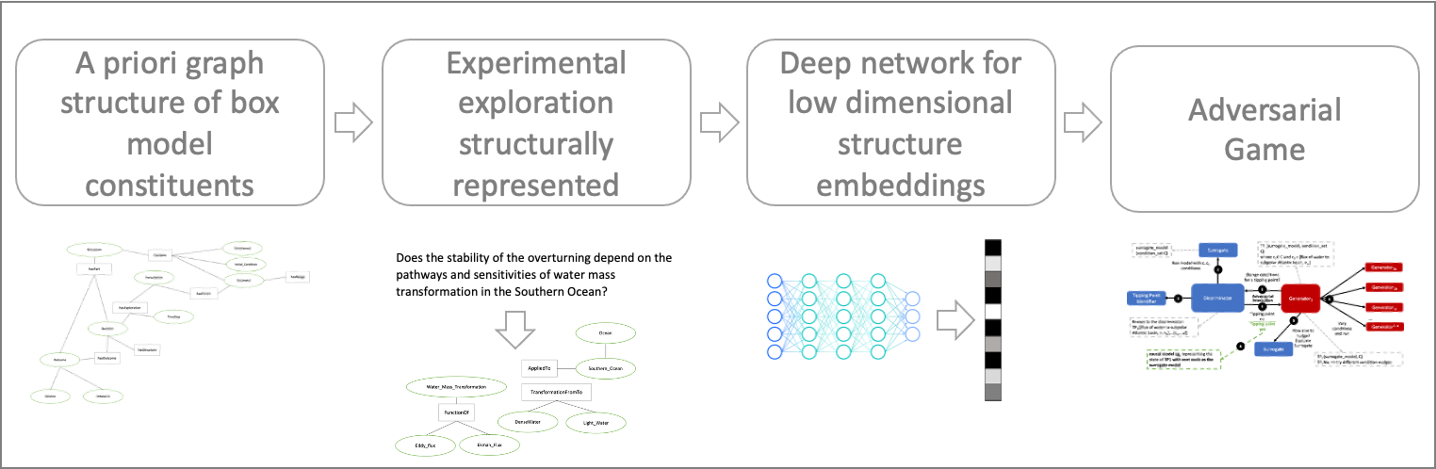
Neuro-Symbolic Language Exploration

Slide 18
What did we learn?
Modeling the AMOC as an adversarial game is challenging
Adaptation: Starting with the Four Box model to reduce complexity, once the architectures are stable, then constraining CMIP and mapping CMIP to the box model parameters for a second level of complexity, then removing CMIP constraints
Building a neuro-symbolic language requires a lot of upfront meetings between oceanography researchers and AI researchers
Adaptation: Again starting with the Four Box model as a use case enabled us to reduce the complexity, we also realized we would likely need a graph-based representation for the language
Symbols need a representation to be given to a deep learning network
Adaptation: We began evaluating Graph Neural Networks, the plan is to create an embedding of the symbolic structures for learning
Mapping CMIP to the parameters in the Four Box model is not an easy task
Adaptation: Required using a new team member with in-depth CMIP understanding

Slide 19
Upcoming Points of Collaboration
Python Box Model Code
Tools for Processing CMIP data
Repository:
https://github.com/JHUAPL/PACMANs
Python box model code expected to be ready in two weeks.

Slide 20
Citations
1. Boers, Niklas. "Observation-based early-warning signals for a collapse of the Atlantic Meridional Overturning Circulation." Nature Climate Change 11, no. 8 (2021): 680-688.
2. Gnanadesikan, A., A simple model for the structure of the oceanic pycnocline, Science., 283:2077-2079, (1999).
3. Forget, G., J.-M. Campin, P. Heimbach, C. N. Hill, R. M. Ponte, C. Wunsch, ECCO version 4: An integrated framework for non-linear inverse modeling and global ocean state estimation. Geosci. Model Dev. 8, 3071–3104 (2015)
4. Gnanadesikan, A., R. Kelson and M. Sten, Flux correction and overturning stability: Insights from a dynamical box model, J. Climate, 31, 9335-9350, https://doi.org/10.1175/JCLI-D-18-0388.1, (2018).
5. Kaufhold, John Patrick, and Jennifer Alexander Sleeman. "Systems and methods for deep model translation generation." U.S. Patent No. 10,504,004. 10 Dec. 2019.
6. Garcez, Artur d'Avila, and Luis C. Lamb. "Neurosymbolic AI: the 3rd Wave." arXiv preprint arXiv:2012.05876 (2020).
7. Stommel, H. Thermohaline convection with two stable regimes of flow. Tellus 13, 224–230 (1961).
8. Karniadakis, George Em, Ioannis G. Kevrekidis, Lu Lu, Paris Perdikaris, Sifan Wang, and Liu Yang. "Physics-informed machine learning." Nature Reviews Physics 3, no. 6 (2021): 422-440.
9. Sleeman, Jennifer, Milton Halem, Zhifeng Yang, Vanessa Caicedo, Belay Demoz, and Ruben Delgado. "A Deep Machine Learning Approach for LIDAR Based Boundary Layer Height Detection." In IGARSS 2020-2020 IEEE International Geoscience and Remote Sensing Symposium, pp. 3676-3679. IEEE, 2020.
10. Patel, Kinjal, Jennifer Sleeman, and Milton Halem. "Physics-aware deep edge detection network." In Remote Sensing of Clouds and the Atmosphere XXVI, vol. 11859, pp. 32-38. SPIE, 2021.
11.Brulé, Joshua. "A causation coefficient and taxonomy of correlation/causation relationships." arXiv preprint arXiv:1708.05069 (2017).
12. Rasp, Stephan, Michael S. Pritchard, and Pierre Gentine. "Deep learning to represent subgrid processes in climate models." Proceedings of the National Academy of Sciences 115, no. 39 (2018): 9684-9689.
13. Bolton, Thomas, and Laure Zanna. "Applications of deep learning to ocean data inference and subgrid parameterization." Journal of Advances in Modeling Earth Systems 11, no. 1 (2019): 376-399.
14. Kurth, Thorsten, Sean Treichler, Joshua Romero, Mayur Mudigonda, Nathan Luehr, Everett Phillips, Ankur Mahesh et al. "Exascale deep learning for climate analytics." In SC18: International Conference for High Performance Computing, Networking, Storage and Analysis, pp. 649-660. IEEE, 2018.

Slide 21
Citations cont.
15. Weber, Theodore, Austin Corotan, Brian Hutchinson, Ben Kravitz, and Robert Link. "Deep learning for creating surrogate models of precipitation in Earth system models." Atmospheric Chemistry and Physics 20, no. 4 (2020): 2303-2317.
16. Matsubara, Takashi, Ai Ishikawa, and Takaharu Yaguchi. "Deep energy-based modeling of discrete-time physics." arXiv preprint arXiv:1905.08604 (2019).
17. Kleinen, T., Held, H. & Petschel-Held, G. The potential role of spectral properties in detecting thresholds in the Earth system: application to the thermohaline circulation. Ocean Dyn. 53, 53–63 (2003).
18. Kocaoglu, Murat, Christopher Snyder, Alexandros G. Dimakis, and Sriram Vishwanath. "Causalgan: Learning causal implicit generative models with adversarial training." arXiv preprint arXiv:1709.02023 (2017).
19. Feinman, Reuben, and Brenden M. Lake. "Learning Task-General Representations with Generative Neuro-Symbolic Modeling." arXiv preprint arXiv:2006.14448 (2020).
20. Yi, Kexin, Chuang Gan, Yunzhu Li, Pushmeet Kohli, Jiajun Wu, Antonio Torralba, and Joshua B. Tenenbaum. "Clevrer: Collision events for video representation and reasoning." arXiv preprint arXiv:1910.01442 (2019).
21. Nowack, Peer, Jakob Runge, Veronika Eyring, and Joanna D. Haigh. "Causal networks for climate model evaluation and constrained projections." Nature communications 11, no. 1 (2020): 1-11.
22. Andersson, Tom R., J. Scott Hosking, María Pérez-Ortiz, Brooks Paige, Andrew Elliott, Chris Russell, Stephen Law et al. "Seasonal Arctic sea ice forecasting with probabilistic deep learning." Nature communications 12, no. 1 (2021): 1-12.
23. Storchan, Victor, Svitlana Vyetrenko, and Tucker Balch. "MAS-GAN: Adversarial Calibration of Multi-Agent Market Simulators." (2020).
24. De Raedt, Luc, Robin Manhaeve, Sebastijan Dumancic, Thomas Demeester, and Angelika Kimmig. "Neuro-symbolic=neural+ logical+ probabilistic." In NeSy'19@ IJCAI, the 14th International Workshop on Neural-Symbolic Learning and Reasoning. 2019.
25. Eyring, V., Bony, S., Meehl, G. A., Senior, C. A., Stevens, B., Stouffer, R. J., and Taylor, K. E.: Overview of the Coupled Model Intercomparison Project Phase 6 (CMIP6) experimental design and organization, Geosci. Model Dev., 9, 1937-1958, doi:10.5194/gmd-9-1937-2016, 2016.
26. Swingedouw, Didier, Chinwe Ifejika Speranza, Annett Bartsch, Gael Durand, Cedric Jamet, Gregory Beaugrand, and Alessandra Conversi. "Early warning from space for a few key tipping points in physical, biological, and social-ecological systems." Surveys in geophysics 41, no. 6 (2020): 1237-1284.
27. Reichstein, Markus, Gustau Camps-Valls, Bjorn Stevens, Martin Jung, Joachim Denzler, and Nuno Carvalhais. "Deep learning and process understanding for data-driven Earth system science." Nature 566, no. 7743 (2019): 195-204.

Slide 22
Citations cont.
28. Sleeman, Jennifer, Ivanka Stajner, Christoph Keller, Milton Halem, Christopher Hamer, Raffaele Montuoro, and Barry Baker. "The Integration of Artificial Intelligence for Improved Operational Air Quality Forecasting." In AGU Fall Meeting 2021. 2021.
29. Bellomo, K., Angeloni, M., Corti, S. et al. Future climate change shaped by inter-model differences in Atlantic meridional overturning circulation response. Nat Commun 12, 3659 (2021). https://doi.org/10.1038/s41467-021-24015-w
30. Sgubin, G., Swingedouw, D., Drijfhout, S. et al. Abrupt cooling over the North Atlantic in modern climate models. Nat Commun 8, 14375 (2017). https://doi.org/10.1038/ncomms14375
31. Swingedouw, D., Bily, A., Esquerdo, C., Borchert, L. F., Sgubin, G., Mignot, J., & Menary, M. (2021). On the risk of abrupt changes in the North Atlantic subpolar gyre in CMIP6 models. Annals of the New York Academy of Sciences, 1504(1), 187-201. https://doi.org/10.1111/nyas.14659
32. Mao, Jiayuan, Chuang Gan, Pushmeet Kohli, Joshua B. Tenenbaum, and Jiajun Wu. "The neuro-symbolic concept learner: Interpreting scenes, words, and sentences from natural supervision." arXiv preprint arXiv:1904.12584 (2019).
This material is based upon work supported by the Defense Advanced Research Projects Agency (DARPA) under Agreement No. HR00112290032.

